Slide 1

Veterans of Foreign Wars of the United Stated States Auxiliary
National Headquarters
Membership Eligibility

Slide 2
What Is Being Covering
Review of the By-Laws covering eligibility
The three pillars of VFW Auxiliary eligibility
What to look for on a DD-214 or other documents

Slide 3
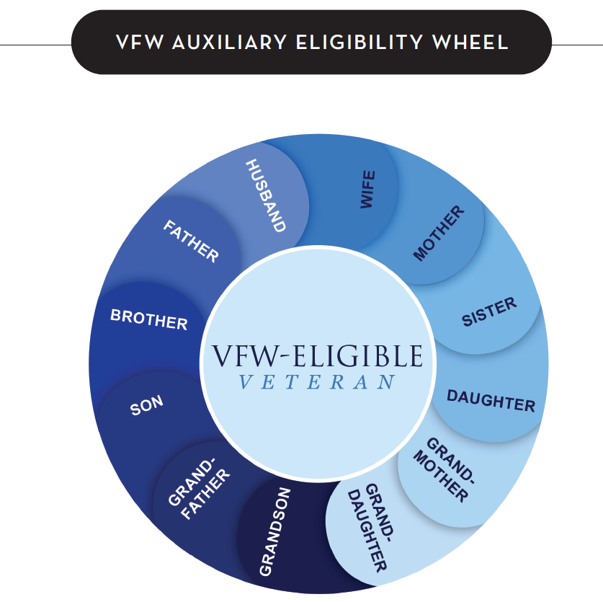
Section 101 of By-Laws
An eligible person for membership is anyone that:
Is not less than sixteen years old and;
Is related to VFW eligible veteran within two degrees of kinship
    Husband / Wife
    Father / Mother
    Son / Daughter
    Brother / Sister
    Widower / Widow
    Grandfather / Grandmother
    Grandson / Granddaughter

Slide 4
Section 101 of By-Laws
A VFW Eligible Veteran is one that has:
Served honorably in the Armed Forces of the United States and:
(2) served in a foreign war, insurrection, or expedition, which service has been recognized as campaign medal service and is governed by the authorization of the award of a campaign badge by the Government of the United States; or
(3) served on the Korean peninsula or in its territorial waters for not less than 30 consecutive days, or a total of 60 days, after June 30, 1949; or
(4) while a member of the armed forces serving in an area which entitled the
individual to receive special pay for duty subject to hostile fire or imminent danger

Slide 5

Pillars of Eligibility
Relationship
Honorable Service
Foreign Conflict
All three must be met!

Slide 6
Relationship
Section 101 restricts membership to closely related relatives of VFW eligible veterans.
Must be related to VFW eligible veteran within two degrees of consanguinity. Must be:
    Husband / Wife *(anyone who is already an Auxiliary member and obtains a divorce shall not have their entitlement to membership questioned as long as they continue to be a member in good standing) **(a person who obtains a divorce from an eligible veteran may not join or rejoin the Auxiliary under that veteran’s eligibility)
    Father / Mother (in-laws are not eligible)
    Son / Daughter (no distinguishment of step-children)
    Brother / Sister (no distinguishment of half-siblings)
    Widower / Widow (a person who was widowed from an eligible veteran may join the Auxiliary even if they have remarried)
    Grandfather / Grandmother
    Grandson / Granddaughter

Slide 7
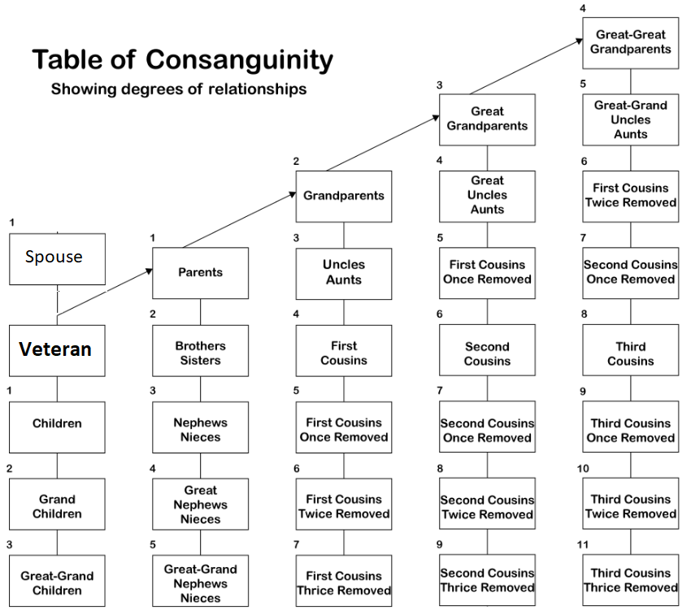
Relationship

Slide 8
Honorable Service
Types of military discharge:
ACCEPTABLE Honorable General General (Under Honorable Conditions) | NOT ACCEPTABLE Other Than Honorable Bad Conduct Undesirable Dishonorable Entry-Level Separation Clemency Uncharacterized

Slide 9
Service in a Foreign Conflict
  Must have either:
  Campaign Ribbon or Medal from those listed in the Bylaws
  Have received Hostile Fire Pay or Imminent Danger Pay
  Have served in Korea for at least 30 consecutive or 60 total days

Slide 10
Campaign Ribbons or Medals
Common mistakes:
World War II Victory Medal (nonqualifying)
Global War On Terrorism Expeditionary Medal (qualifying) vs Global War On Terrorism Service Medal (nonqualifying)
National Defense Service Medal (nonqualifying)
Make sure to always verify the correct awards!

Slide 11
Hostile Fire & Imminent Danger Pay
  Not the same as Hazardous Duty Pay!
  Hostile Fire Pay = was physically under enemy fire or in the vicinity of an exploded enemy munition. (Event-Based)
  Imminent Danger Pay = was in a location where enemy action was occurring or likely to occur. (Location-Based)
  Started in 1971 (Cambodia) and 1973 (Vietnam), anything prior is not the same thing

Slide 12
DD-214, What to Look For?
Character of Service
  If not shown, request Copy 2. May request this from the National Personnel Records Center (www.archives.gov).
  Narrative reason for separation does not matter. Only the character of service.
Awards, Decorations, and Medals
  Usually, a large block on the lower half of the form.

Slide 13
Other Useful Documents
Other useful documents include
DD-256: Certificate of Honorable Discharge
Leave & Earnings Statement (LES)
Travel Orders or Memorandums
Other official military documentation stating the necessary information.
MAY NOT use headstone/gravestone as proof of eligibility

Slide 14
What About Navy Ships?
  https://goatlocker.org/resources/nav/1650.pdf
From 1954 through 2003, the Navy would often award campaign medals to a specific ship. Every sailor and marine on board would be eligible for the award.
However, if the veteran was discharged from a shore station, the veteran may not have had the paperwork showing those awards, and they might not have been included on the DD-214.
If the ship name and dates the veteran was aboard, the ship can be researched in OPNAV-1650, the Navy’s Operational Document recording all medals awarded to a Navy vessel.

Slide 15
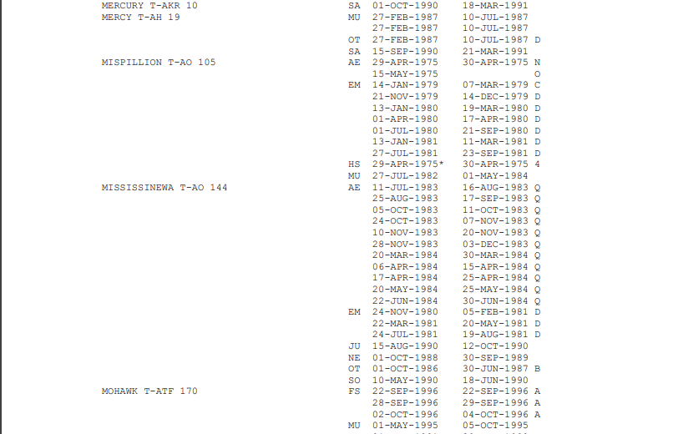
What About Navy Ships?
This is an example page from OPNAV-1650. It shows the ship, hull number, and the dates for which it was awarded a specific medal.
The beginning of the document shows a list of the medals.
Relevant to VFW Membership are: Vietnam Service Medal (VS), Navy Expeditionary Medal (EM), Combat Action Ribbon (CR), Armed Forces Expeditionary Medal (AE), and Southwest Asia Service Medal (SA).

Slide 16
Why Check Eligibility?
It’s the law! Not just VFW Auxiliary Bylaws, but IRS regulations as well!
YOU are responsible for ensuring EVERY member of your Auxiliary is eligible!
Always confirm eligibility when:
  Signing up a new member
  Rejoining any person who let their membership terminate

Slide 17

Summary
Three pillars of VFW Auxiliary eligibility: Relationship, Honorable Service, Foreign Conflict.
Make sure to verify eligibility for ALL members.
Know how to read a DD-214 or other documents.
Be familiar with the qualifying campaign ribbons or medals as listed in the Bylaws.

